Slide 1
PR-03-27: Lead Service Line Inventory
Bidders’ Presentation

Slide 2

What is VIWAPA?
The Virgin Islands Water and Power Authority (VIWAPA) is a semi-autonomous agency of the U.S. Virgin Islands government that was created by the Fifth Legislature of the Virgin Islands in 1964.
VIWAPA owns and operates the power generation plant and potable water distribution system in USVI and provides services to its customers on St. Croix, St. Thomas, Water Island, and Hassel Island.

Slide 3
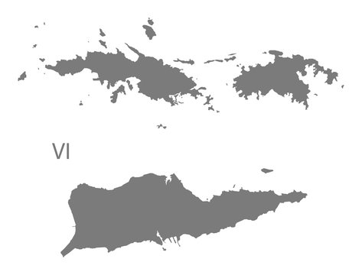
VIWAPA Potable Water System
Overview by District
St. Croix District
168 miles of water main
3 pump stations, 1 booster station
8 storage tanks with a total capacity of 23.4 MG
Approximately 9,734 service locations
St. Thomas- St. John District
80 miles of water main (STT) / 3 miles of water main (STJ)
13 pump stations¹ (STT) / 1 pump station (STJ)
4 storage tanks with a total capacity of 37 MG (STT) / 4 storage tanks with total capacity of 1.5 MG (STJ)
Approximately 6,660 service locations

Slide 4

Regulatory Background
& Project Need
This project is 100% funded by the EPA Drinking Water State Revolving Fund
In 2021, the EPA issued the Lead and Copper Rule Revisions (LCRR), strengthening the 1991 Lead and Copper Rule to protect communities from lead exposure in potable water.
The LCRR required public water systems, like VIWAPA, to inventory all service lines materials. This project will verify all unknown service line materials and provide VIWAPA information needed to maintain its inventory and plan future replacements.
In 2024, EPA finalized the Lead and Copper Rule Improvements, which require an updated baseline inventory by November 1, 2027.
  VIWAPA submitted their baseline inventory to the EPA in Jan. 2026

Slide 5

Scope of Work
The scope of work includes the field investigation of approximately 16,490 service connections across the territory:
  St. Croix District: Approx. 9,734 service connections
  St. Thomas-St. John District: Approx. 6,756 service connections
During field investigations, the selected Contractor is expected to:
  Vacuum excavate (pothole) each sides of meter box and expose at least 18 inches
  Identify service line material
  Collect centimeter-accuracy GIS coordinates and photographs
  Obtain required permits (as applicable) and restore disturbed areas to its original condition.
  Deliver an ArcGIS-compatible inventory and map identifying materials on both the utility and customer sides, including priority lead and galvanized requiring replacement locations.

Slide 6
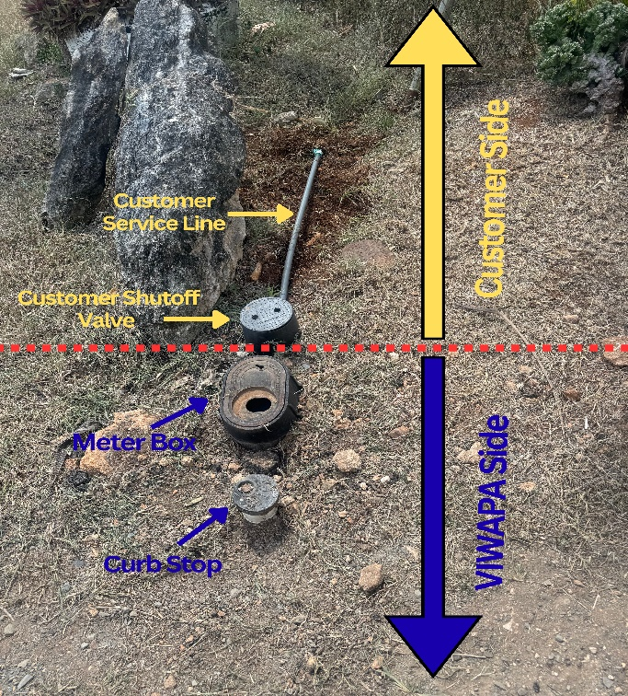
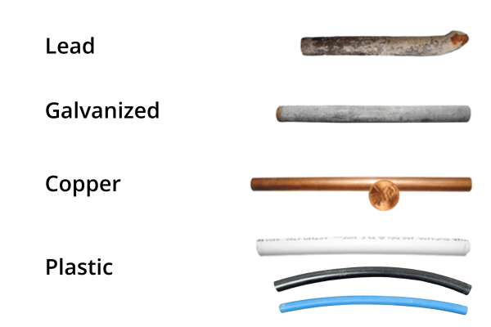
Field Investigation
Requirements
Photograph site before & after investigation
Visually inspect and classify exposed piping and visible components using scratch test, magnetic test, and swab test¹ (confirmatory; 2 swabs per site) methods
Classifications include:
  Non-Lead (copper, plastic, brass)
  Lead
  Galvanized Requiring Replacement (galvanize piping downstream of lead piping)
Report severely corroded or damaged lines without testing
Repair investigation area to its pre-existing or better condition

Slide 7

Data Collection & Documentation Requirements
Awarded Bidder shall provide and maintain its own ArcGIS license, field equipment, cellular-enabled tablets, and a maintain minimum of five (5) field worker accounts
One GIS record shall be created for each service line investigation site. Each record shall include:
  Site address and meter number
  Inspection date and GPS coordinates
  Material classification on the utility and customer side
  Lead-status classification
  Test method and result
  Visible component materials (where applicable)
  Linked photographs of the exposed lines, test results, and site conditions before and after excavation
  Site condition and exception notes
All coordinates shall be collected with survey-grade, centimeter-accuracy

Slide 8
Customer Notification
& Access Coordination
VIWAPA will provide the Awarded Bidder with door hangers for distribution before field investigations begins
The Awarded Bidder shall distribute the door hangers to each property scheduled for investigation
Field investigations is expected to occur primarily within the public right-of-way.
  When walls, fences, or other obstructions require access to private property, the Awarded Bidder shall contact the property owner in advance, coordinate the inspection, and obtain a signed right-of-entry form before entering the property.
The Bidder shall document doorhanger distribution and all access attempts, including denied access, no responses, and inaccessible locations.

Slide 9
Payment Schedule & Project Reporting
Milestone | Percentage
Mobilization | 10%
50% Completion of STT/STJ Service Line Investigation (approximately 3,378 service lines of STT/STJ investigated) | 20%
100% Completion of STT/STJ Service Line Investigation (all service lines investigated in STT/STJ District) | 20%
50% Completion of STX Service Line Investigation (approximately 4,867 service lines of STX investigated) | 20%
100% Completion of STX Service Line Investigation (all service lines investigated in STX District) | 20%
Final Report & Data Finalization | 10%
Weekly Progress Report
The Awarded Bidder shall submit a typed weekly report that includes, at minimum:
  The number and percentage of service lines verified, including the material classification with photographs
  Work completed during report period and areas scheduled for the next reporting period
  Access limitations, project risks, and mitigation actions.
7

Slide 10

Evaluation Criteria & Bid Tab
Evaluation Criteria | Evaluation Details | Weight (100)
Technical Capability | Demonstrated ability to perform excavation, and material identification. Demonstrated ability to collect, manage, and submit GIS data and documentation in the required ArcGIS-compatible format, including photo documentation and required inventory attributes. | 30
Experience and Qualification | Relevant experience performing similar projects, including work done under the EPA or other federal environmental regulatory requirements | 25
Project Schedule | Ability to complete project in a timely, efficient manner | 20
Project Approach | Approach on getting project completed in a timely, efficient manner | 15
Bid Responsiveness | Completeness of the bid submittal and compliance with all requirements, terms, and conditions of this IFB, inclusive demonstrated possession of required ArcGIS licenses and accounts. | 10

Slide 11
Final Deliverables
By the end of the project, VIWAPA expects a complete, territory-wide service line inventory consistent with EPA’s requirements. The final deliverables shall include:
A GIS-based map and ArcGIS Online-compatible dataset showing service locations and material classifications on both the utility and customer sides
An Esri file geodatabase (.gdb) file with supporting field verification records, records review findings, and linked photographs.
A final report identifying high-priority areas with lead or galvanized requiring replacement service lines to support future replacement planning.

Slide 12
Important Dates to Remember
Deadline for Questions: September 18, 3pm AST
Responses to Questions: September 25, 4pm AST
Bid Submittal Deadline: October 2, 10 am AST
All communication and requests for additional information should be done through WAPA Contracts team via email at contractservices@viwapa.vi.
Full packages must be submitted. Any submittals without all supporting documentation will NOT be processed!

Slide 13


Thank You!
Virgin Islands Water & Power Authority

